Slide 1
What Makes Data Suitable for Deep Learning?
Yotam Alexander
Tel Aviv University

Slide 2





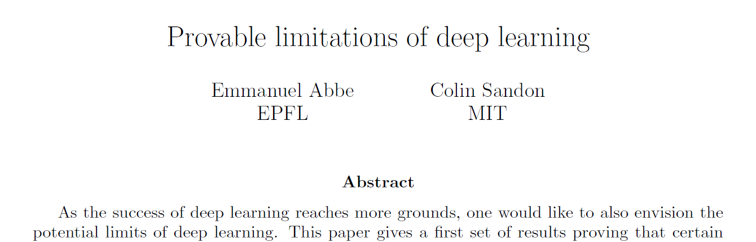
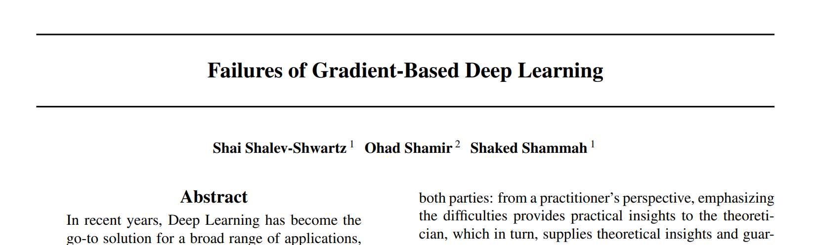
Images
Audio
Text
What makes data suitable for deep learning?

Slide 3
Source
What Makes Data Suitable for a Locally Connected Neural Network? A Necessary and Sufficient Condition Based on Quantum Entanglement
Yotam Alexander + Nimrod De La Vega + Noam Razin + Nadav Cohen
arXiv

Slide 4
Outline
The Role of Data Distributions in Deep Learning
An Appeal to Quantum Physics
Characterization of Data Suitable for Locally Connected Neural Networks
Conclusion

Slide 5
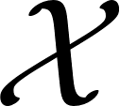

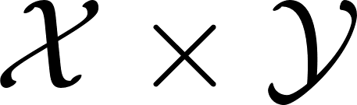
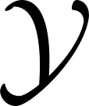
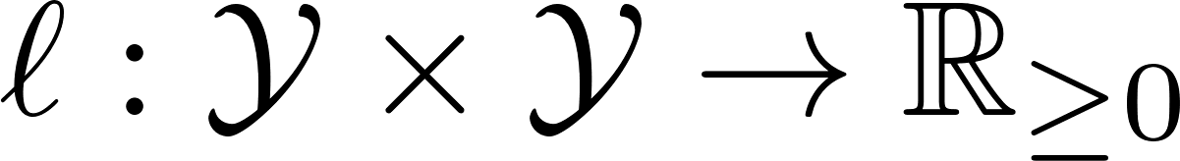
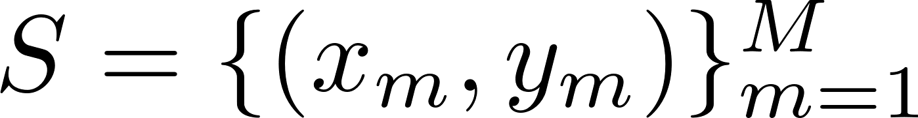
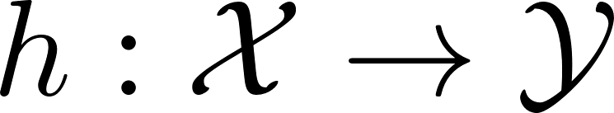
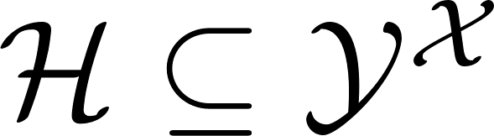
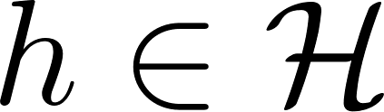
Statistical Learning Setup
- instance space
- distribution over (unknown)
- label space
- loss function
Task
Given training set drawn i.i.d. from , return hypothesis
that minimizes population loss:
Approach
Predetermine hypotheses space and return that minimizes empirical loss:

Slide 6
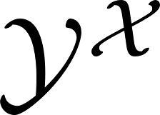
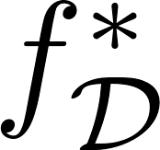

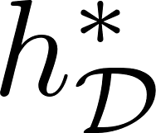
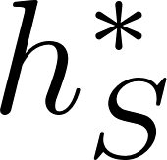
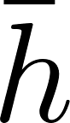
Three Pillars of Statistical Learning Theory: Expressiveness, Generalization and Optimization
(all functions)
(hypotheses space)
Approximation Error
(Expressiveness)
Estimation Error
(Generalization)
Training Error
(Optimization)
- ground truth (minimizer of population loss over )
- optimal hypothesis (minimizer of population loss over )
- empirically optimal hypothesis (minimizer of empirical loss over )
- returned hypotheiss

Slide 7

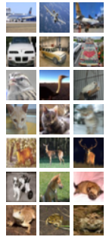


Deep Learning
Overparameterized deep neural networks (DNNs) trained via gradient descent (GD) yield unprecedentedly low population loss
all functions
low approximation error
$$≫$$
hypotheses space
# of learned weights
training set size
low training error
low estimation error
Training error: GD on poly-sized DNN converges to global min with arbitrary data distribution
(Jacot et al. 2018, Du et al. 2019, Allen-Zhu et al. 2019, Zou et al. 2020)
Approximation error: poly-sized DNN can express hypothesis with low population loss only for some data distributions
(e.g. Telgarsky 2016)
Estimation error: GD on DNN leads to optimal population loss only for some data distributions
(Zhang et al. 2017, Shalev-Shwartz et al. 2017, Abbe & Sandon 2018)
What makes data suitable for deep learning?

Slide 8


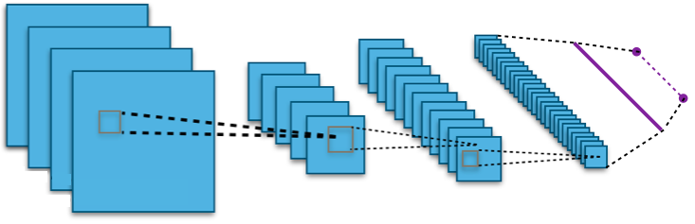
What Makes Data Suitable for Deep Learning?
Why study suitability of data for deep learning?
Aside from scientific curiosity, can lead to methods for:
Adapting data to neural networks (NNs)
Adapting NNs to data

Slide 9


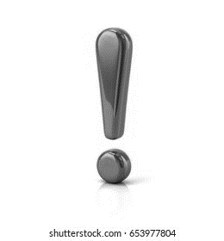

What Makes Data Suitable for Deep Learning?
We focus on expressiveness
all functions
low approximation error
hypotheses space
low training error
low estimation error
Existing literature:
Restrictive sufficient conditions on data distribution (e.g. Gaussian)
Missing characterizations with necessary and sufficient conditions
(Brutzkus & Globerson 2017, Du et al. 2018, Oymak & Soltanolkotabi 2018, Brutzkus et al. 2022)

Slide 10
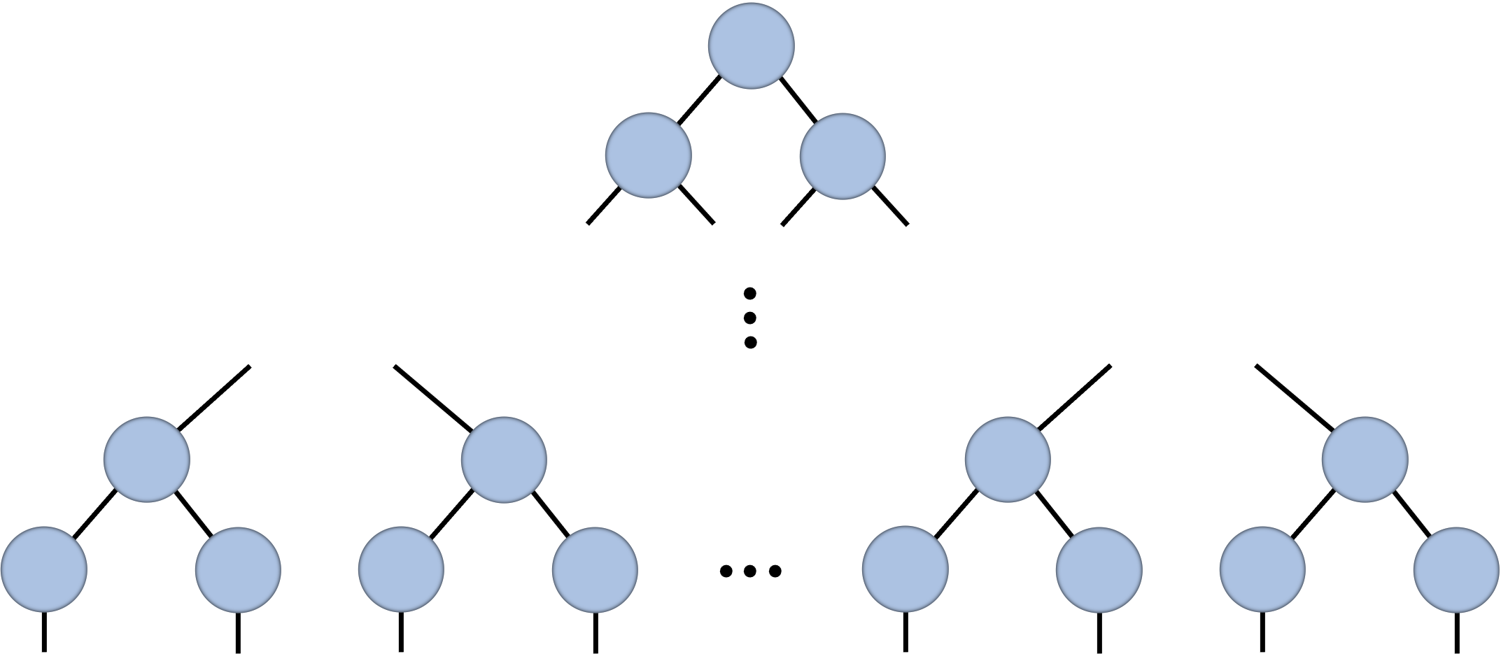
Quantum Physics
Seemingly distinct scientific discipline tying distributions and computational models
Deep learning
Quantum physics
Distribution
Data
Tensor
Computational
model
NN
Tensor network

Slide 11
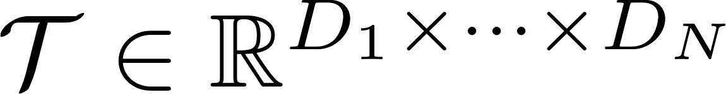






Tensors and Tensor Networks
Tensor – multi-dimensional array
Tensor networks (TNs) – graphs in which:
vertices
tensors
edges
axes
scalar
vector
matrix
3-dim tensor
edge connecting two vertices (tensors) represents contraction
inner product
matrix multiplication

Slide 12
Assessing Suitability of Distribution to Computational Model
Deep learning
Quantum physics
Distribution
Data
Tensor
Computational
model
NN
TN
Theory for suitability
of distribution to model
based on
quantum entanglement
❌
✅

Slide 13
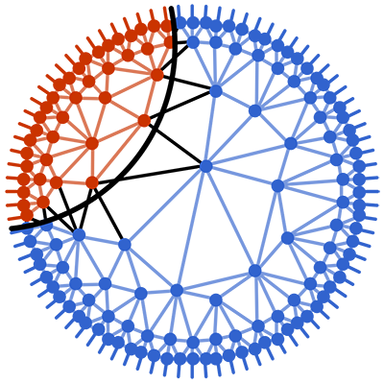
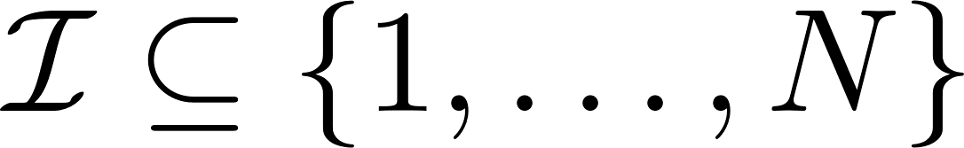
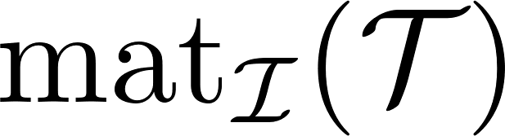
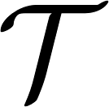
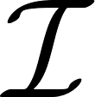
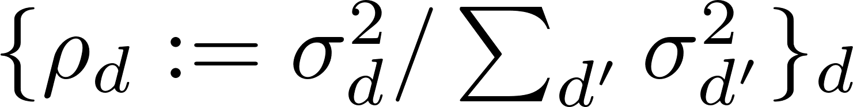
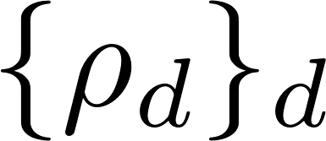
Quantum Entanglement
Quantifies dependencies that tensor admits under partitions of its axes
Let and
– arrangement of as matrix with axes in unrolled as rows
– distribution induced by singular values of
(entropy of )

Slide 14
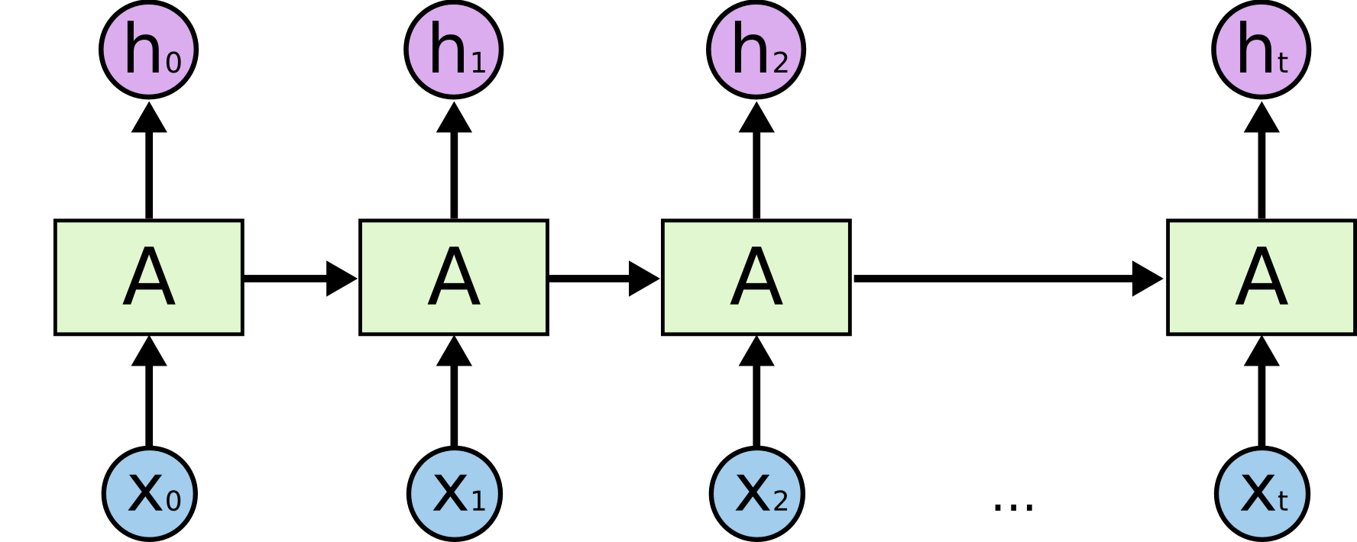
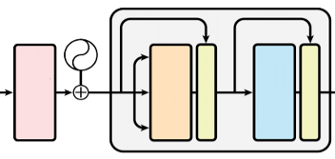
Locally Connected NNs
Prevalent family of deep learning architectures, including:
Convolutional NNs
Recurrent NNs
Local Self-Attention Models

Slide 15
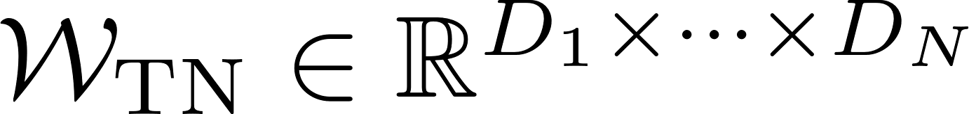
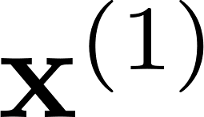
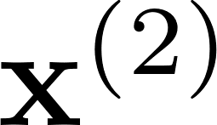
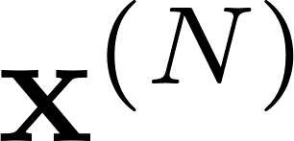
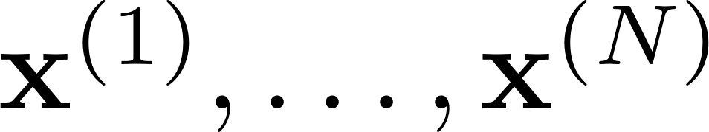
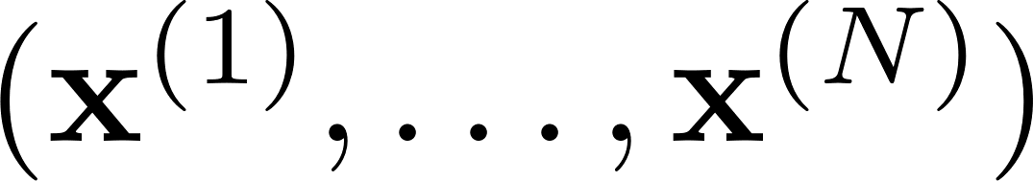
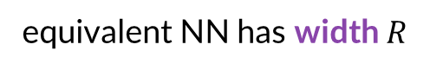
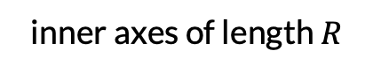
TN Equivalent to a Locally Connected NN
Locally Connected TN
Generates via perfect tree
inner axes of length $R$
equivalent NN has width $R$
Contracting with
forward pass of locally connected NN
results in
( C et al. 2016)
with (poly non-linearity) over

Slide 16
Locally Connected TN
Delivers competitive empirical performance
(C et al. 2016a, Stoudenmire 2018)
Enabled analyses of expressiveness and implicit regularization in deep learning
(C et al. 2016b, C & Shashua 2017, Levine et al. 2018, Khrulkov et al. 2018, Razin et al. 2021;2022)
Analyses led to insights and practical tools for widespread locally connected NNs
(C et al. 2016b, C & Shashua 2017, Levine et al. 2018, Khrulkov et al. 2018, Razin et al. 2021;2022)

Slide 17
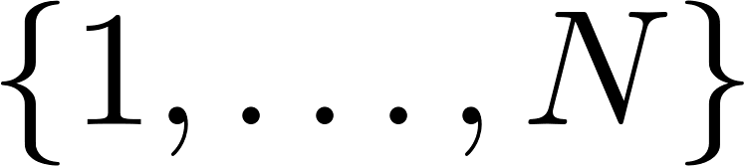
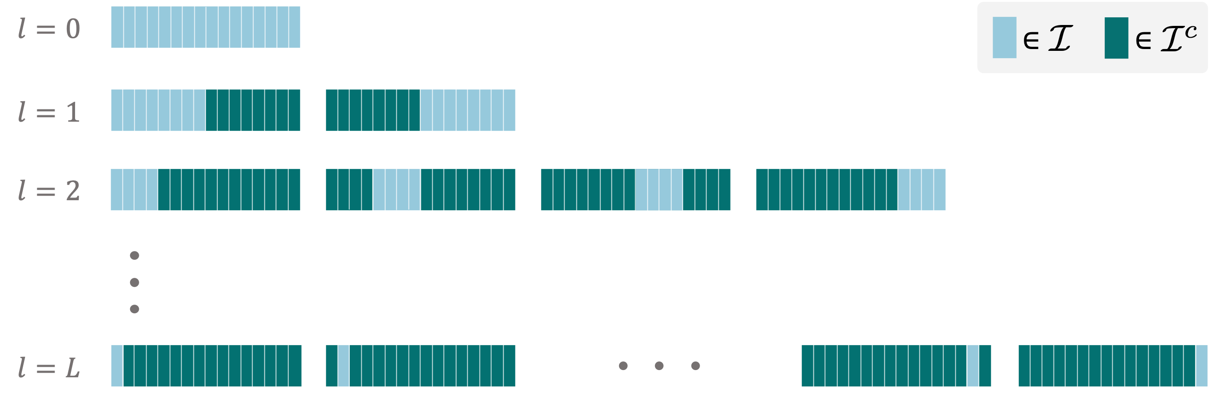
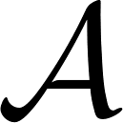
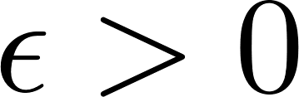
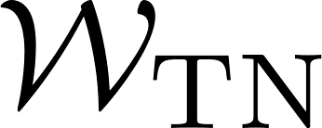
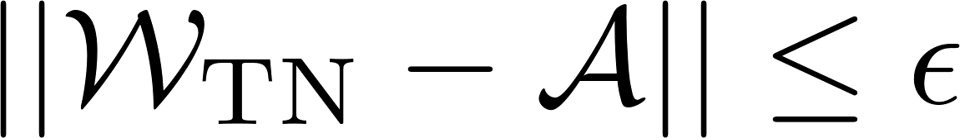
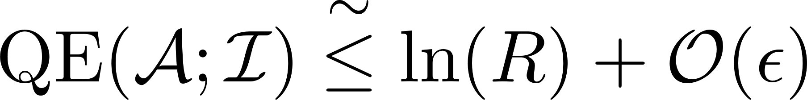
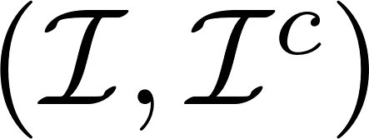
Necessary and Sufficient Condition for Fitting Tensor
Canonical Partitions of :
d d d
Theorem
For a tensor and , there exist s.t.
if and only if
for all canonical partitions
width

Slide 18
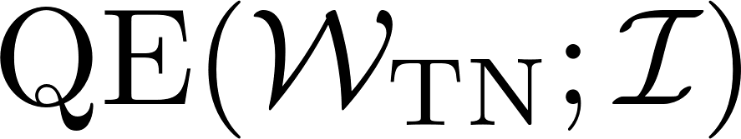
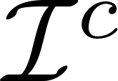

Necessary and Sufficient Condition for Fitting Tensor
d d d
Theorem
For a tensor and , there exist s.t.
if and only if
for all canonical partitions
Proof Sketch
depends logarithmically on min cut in TN graph separating axes from
For canonical partition min cut

Slide 19
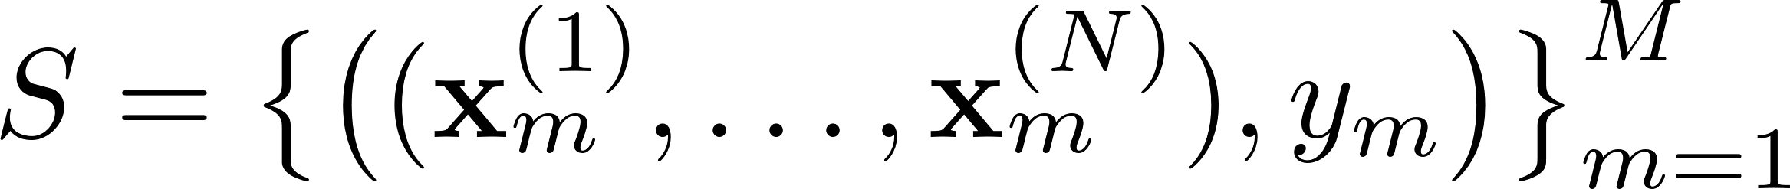
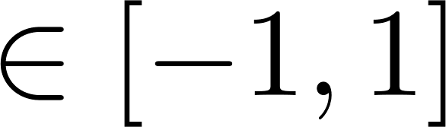
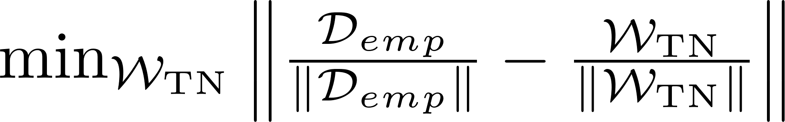


Accurate Prediction is Equivalent to Fitting Data Tensor
Classification Setting:
Given training set
where
learn parameters of locally connected TN via soft-SVM objective:
$$(∗)$$
Empirical data tensor:
$$(∗)$$
It can be shown that is equivalent to

Slide 20



Accurate Prediction is Equivalent to Fitting Data Tensor
Achievable accuracy over training set determined by
Similar arguments apply to population loss, with replaced by:
Population data tensor:
Achievable accuracy over population determined by
Supoptimality in achievable accuracy:

Slide 21



Necessary and Sufficent Condition for Accurate Prediction
Supoptimality in achievable accuracy:
d d d
Theorem
For a tensor and , there exist s.t.
if and only if
for all canonical partitions
d d d
Corollary
if and only if
for all canonical partitions
Accurate prediction is possible if and only if data distribution
admits low entanglement under canonical partitions of features

Slide 22




Evaluating Entanglements of Data
d d d
Corollary
if and only if
for all canonical partitions
Question: how can we evaluate ?
d d d
Proposition
For , if the training set size ,
then w.p. , for all :
Moreover, can be computed efficiently
Sufficient and necessary condition for accurate prediction can be evaluated efficiently

Slide 23


Slide 24
Empirical Demonstration of Theory
d d d
Corollary
if and only if
for all canonical partitions
Experiment
Data: audio classification task with random position swaps between features
Performance of locally connected NNs is inversely correlated
with entanglements under canonical partitions of features in data

Slide 25

Practical Application: Adapting Data to Locally Connected NNs
Theory suggests:
Admits low entanglement under canonical partitions of features
Data suitable for locally connected NN
Question:
Can we enhance suitability of data to locally connected NNs by arranging features s.t. low entanglement under canonical partitions is attained?

Slide 26
Practical Application: Adapting Data to Locally Connected NNs
Algorithm: greedy coarse-to-fine search for feature arrangement
Balanced partition
with minimal entanglement
New feature index:
1
2
3
4
5
6
7
8
9
10
11
12
13
14
15
16
Problem: finding balanced partition minimizing entanglement is computationally prohibitive
Workaround: replace entanglement with surrogate based on Pearson correlation
algorithm reduces to sequence of min balanced cut problems (can use well-established tools)

Slide 27


Slide 28




Empirical Evaluation
Baseline: IGTD – heuristic arrangement of features designed for convolutional NNs
(Zhu et al. 2021)
Randomly Permuted Audio Datasets
Tabular Benchmarks
Important in
high-dim settings
Our method renders locally connected NNs viable for tabular data

Slide 29
Recap
Overparameterized DNNs trained via GD yield unprecedently low population loss
low approximation error
We study this via tools from quantum physics
all functions
low approximation error
all functions
hypotheses space
hypotheses space
Rely on properties of data distribution
Rely on properties of data distribution
low training error
low training error
low estimation error
low estimation error
Locally Connected NNs
Theory: accurate prediction is possible if and only if data admits low entanglement under canonical partitions
Practical application: enhancing suitability of data via feature arrangement

Slide 30





Reasoning About Natural Data via Physics
Deep learning is most commonly applied to data modalities regarded as natural
Images
Text
Audio
Difficult to formalize since we lack tools for reasoning about natural data
Physics may be key to overcoming this difficulty

Slide 31
Thank You!

